Slide 1




PHS LIBRARY APP
MASON DALE
PLYMOUTH HIGH SCHOOL
FBLA MOBILE APPLICATION DEVELOPMENT
Project Description
Created a mobile application for a library that allows patrons to reserve and check out books.
Developed on Xcode IDE
Swift Programming Language
App provides:
Information about the library
Map of the library
Ability to check out/reserve books

Slide 2
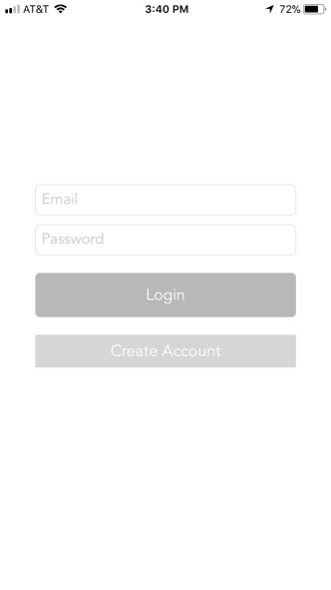
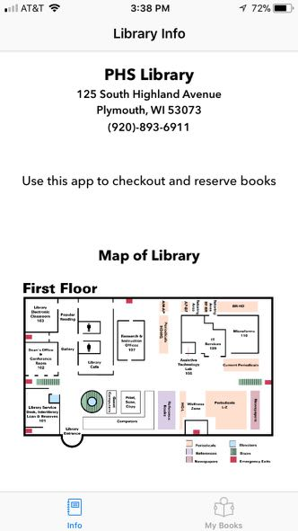
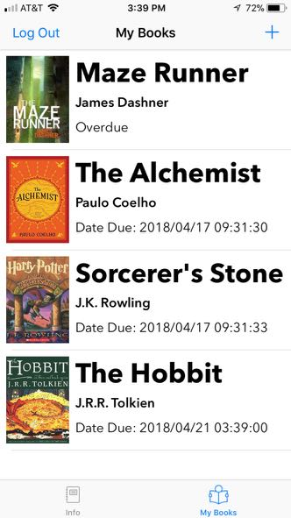
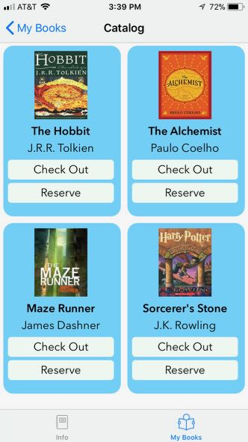
Screen Shots
Project Description
Created a mobile application for a library that allows patrons to reserve and check out books
Developed on Xcode IDE
Swift Programming Language
App provides:
Information about the library
Map of the library
Ability to check out/reserve books
View book due date
Login
Library Information
User Book List
Check Out

Slide 3
Screenshots
Login
Library Information
User Book List
Check Out
Planning

Slide 4
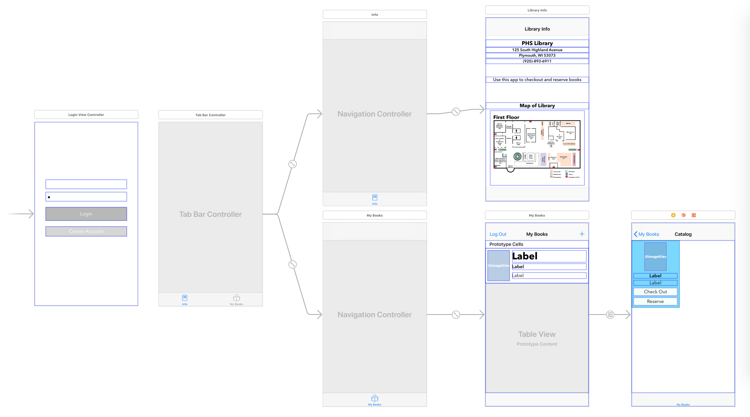
Planning
App Storyboard

Slide 5
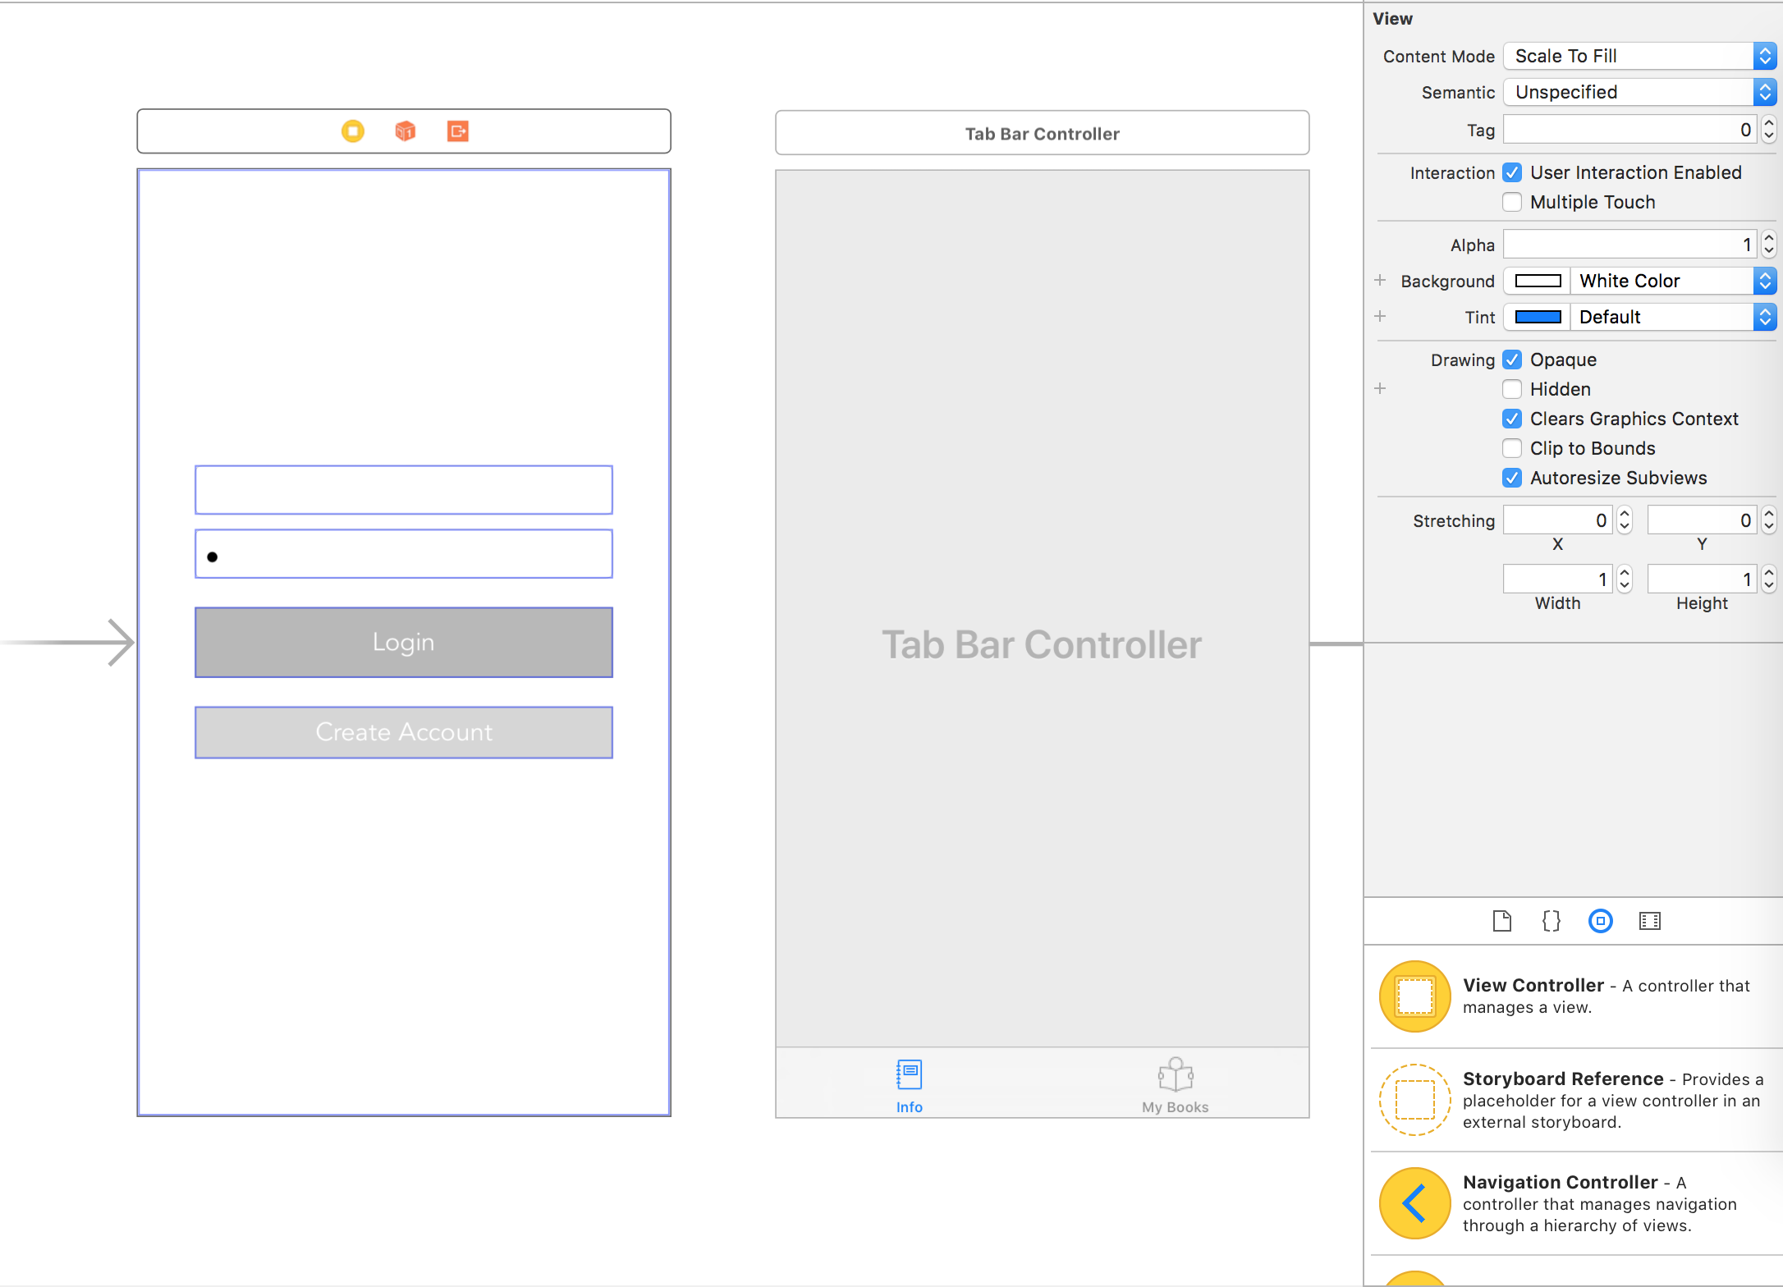
App Storyboard
Storyboard - Editing VC's

Slide 6
Storyboard - Editing VC's
Interface I/O

Slide 7

Interface I/O
Interface I/O
Data was stored and handled using
Google's Firebase

Slide 8

Data was stored and handled using
Google's Firebase
Interface I/O
Image from: https://firebase.google.com/
Interface I/O
User inputs email/password for account login or creation
With fields filled, either button will bring user into app

Slide 9

User inputs email/password for account login or creation
Interface I/O
With fields filled, either button will bring user into app
Interface I/O
Tab Bar Controller allows users to swap between pages

Slide 10

Tab Bar Controller allows users to swap between pages
Interface I/O
Interface I/O
User logout button
Database Output
User may scroll on this page
"+" button at top-right brings user to library catalog

Slide 11
User logout button
Interface I/O
Database Output
User may scroll on this page
"+" button at top-right brings user to library catalog
Interface I/O
Check Out button input adds book object to user's My Books page and database
Navigation controller button that brings user back to My Books page
Same as Check Out button, but the book's status is Reserved
User may scroll on this page

Slide 12
Navigation controller button brings user back to My Books page
Interface I/O
Check Out button input adds book object to user's My Books page and database
Same as Check Out button, but the book's status is Reserved
Database Output
User may scroll on this page
Application Flow and Structure

Slide 13
Application Flow and Structure
Application Flow/Structure

Slide 14
Initially, user is presented this screen during first use
Once user is logged in, they can bypass login screen
Application Flow/Structure
Application Flow/Structure

Slide 15
Initially, user is presented this screen during first use
Once user is logged in, they can bypass login screen
Application Flow/Structure
Application Flow/Structure
Core of app structured on Tab Bar Model
First screen presented after login

Slide 16
Core of app structured on Tab Bar Model
Application Flow/Structure
First screen presented after login
Application Flow/Structure
Navigation Controller Model built into Tab Bar Model

Slide 17
Navigation Controller Model built into Tab Bar Model
Application Flow/Structure
Application Usefulness

Slide 18

Application Usefulness
Application Usefulness
Convenient Digital Option
Applicable for all ages
User Friendly
Intuitive App
Saves the library time and resources
Quick and easy way to reserve and pre-checkout books

Slide 19
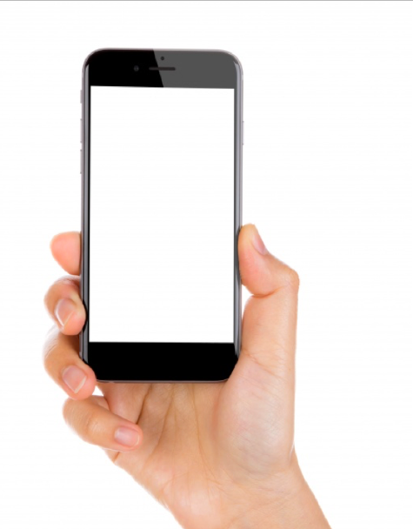
User Friendly
Application Usefulness
Convenient Digital Option
Applicable for all ages
Intuitive App
Saves the library time and resources
Quick and easy way to reserve and pre-checkout books
PHS
Library
App
Get The I Phone App >
Get The iPhone App >

Slide 20
PHS
Library
App
Get The iPhone App >

